Slide 1

AMINO ACIDS
BIOCHEMISTRY

Slide 2
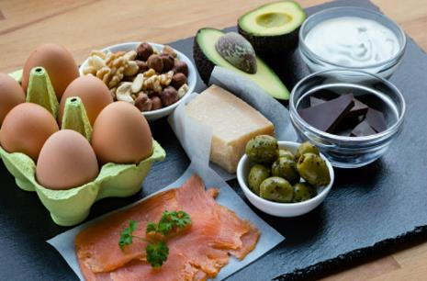
Three Sources of Energy
Proteins
Fats
Sugars

Slide 3
Proteins
The Main Intracellular Buffers

Slide 4
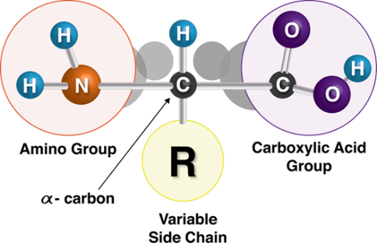
AMINO ACIDS
Figure 3.1 Amino Acid Structure

Slide 5
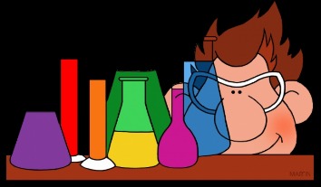
Acid vs. Base
Dissociates early
Likes to give up hydrogen ions (protons)
Pka is less than 7
Strong acid: Pka 1 to 3
Weak acid: Pka 4 to 7
An Acid (Pka is less than 7)

Slide 6

Acid Vs. Base
A Base (Pka is greater than 7)
Dissociates later
Likes to accept hydrogen ions (protons)
Pka greater than 7
Weak base: Pka 7 to 9
Strong base: Pka greater than 9

Slide 7
Remember
Pka 4 to 9 = Could be a weak acid or a weak base

Slide 8
Three Easy Words That are Hard To Understand
Dissociate: to lose a hydrogen (proton)
Soluble: charged or polar; water soluble
Bioavailable: neutral; fat soluble

Slide 9
As an Acid Dissociates…
It gains a negative charge
It gains solubility
It loses bioavailability

Slide 10
As a Base Dissociates…
It loses its positive charge
It loses solubility
It gains bioavailability

Slide 11
Henderson-Hasselback Equation
The Root of Acid Base, Toxicology, Pharmacology and More

Slide 12
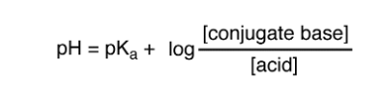
Henderson-Hasselback Equation

Slide 13
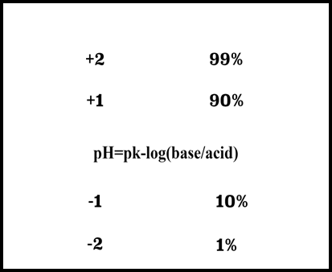
Henderson-Hasselback Equation
Figure 3.3 Acid-Base Dissociation

Slide 14
Acids
IF you want to absorb more…
  Add more Acid
IF you don’t want to absorb it…
  Add base

Slide 15
Base
IF you want to absorb more…
  Add more base
IF you don’t want to absorb it…
  Add acid

Slide 16
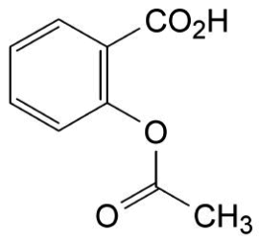
Acids You Need to Know
Aspirin
Barbiturates
Myoglobin
TCAs

Slide 17
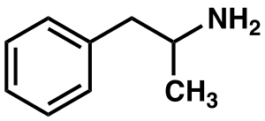
Bases You Need to Know
Amphetamines

Slide 18
What is the main acid used in medicine?
NH₄Cl

Slide 19
What is the main base used in medicine?
NaHCO₃

Slide 20
Isoelectric Point
How Amino Acids Change in Aging

Slide 21
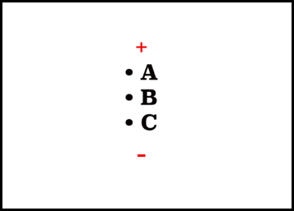
Isoelectric Point
NO NET charge on the molecule
Also called a zwitterion
Will NOT migrate towards anode or cathode
Figure 3.4 Isoelectric Point Migration

Slide 22
Cathode & Anode
Cathode
  Where CATIONS go: the negative electrode
Anode
  Where ANIONS go: the positive electrode

Slide 23
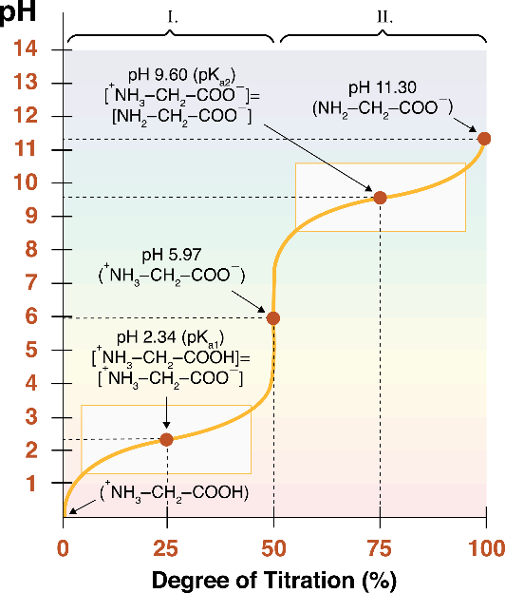
Titration Curve
Figure 3.5 Titration Curve

Slide 24
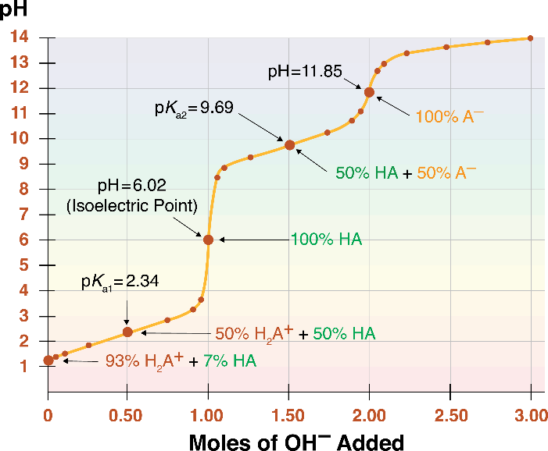
Titration Curve
Figure 3.6 Titration Curve

Slide 25
All Other Amino Acids

Slide 26
Other Amino Acids
Glycine
Phe, Trp, Tyr
Smallest amino acid
NO chiral carbon
Inhibitory neurotransmitter for the spinal cord
Aromatic amino acids
Recognized by chymotrypsin

Slide 27
More Amino Acids
Lys, Arg
Asp, Glu
Basic amino acids
Have a positive charge
Recognized by trypsin
Acidic amino acids
Asp: The main amino acid used for reinforcement of behavior (NMDA pathway)

Slide 28
More Amino Acids
Cys, Met
Contain Sulphur
Make Disulfide bonds

Slide 29
More Amino Acids
Asparagine, Glutamine
Serine, Threonine, Tyrosine
Involved in N- bonds
Involved in O- bonds

Slide 30
More Amino Acids
Leu, Iso, Val
Tyr
Branched chain amino acids
Used to make catecholamines
Used to make melanin

Slide 31
More Amino Acids
Trp
Used to make serotonin

Slide 32
Ketogenic Amino Acids
Lysine
Leucine

Slide 33
GABA Connection
NH4 (Ammonium) + αKG (alpha ketoglutarate) —> Glutamate to GABA
Note: Ammonium comes from urea and acid: NH3 + H=NH4+

Slide 34
Both Glucogenic and Ketogenic
PHE
ISO
THR
TRP

Slide 35
Glucogenic Amino Acids
ALL OTHERS

Slide 36
Essential Amino Acids
You get them ONLY from the diet
NO cycle in YOUR body can make these
A deficiency will ALWAYS lead to a disease
Deficiencies put the body into a starvation state

Slide 37
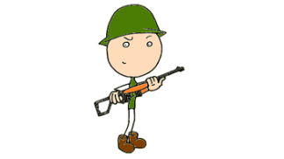
Essential Amino Acids
10 Essential Amino Acids:
Phenylalanine
Histidine
Valine
Arginine
Threonine
Lysine
Tryptophan
Leucine
Isoleucine
Methionine
(Pvt Tim Hall)

Slide 38
How does the body utilize energy during starvation?

Slide 39
Energy Utilization
(1) plasma glucose lasts 2 to 4 hours
(2) liver glycogen: lasts 24 to 28 hours
(3) proteolysis for gluconeogenesis
(4) lipolysis
(5) ketogenesis

Slide 40
Notables
PHE used to make TYR
  TYR becomes essential if PHE is deficient
MET used to make CYS
  CYS becomes essential if MET is deficient

Slide 41
Phenylketonuria
Phenylalanine hydroxylase is deficient
Unable to make tyrosine
  Unable to make DA and NE and EPI
Unable to make melanin without tyrosine
  Blonde hair; blue eyes; fair skin
Phenylacetate and phenylpyruvate build up
  Musty odor

Slide 42
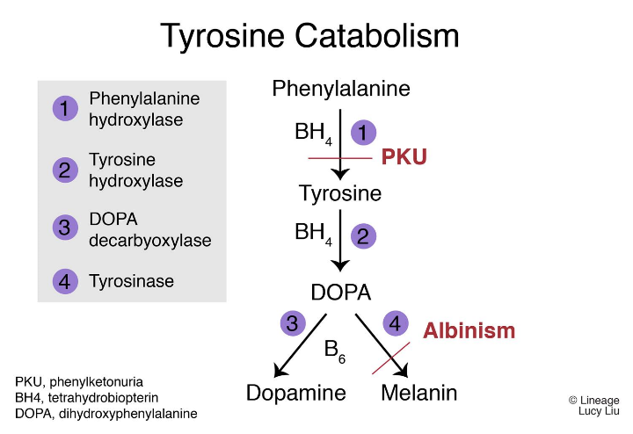
AMINO ACIDS
Figure 3.9 Tyrosine Catabolism

Slide 43
Phenylketonuria
Phenylalanine hydroxylase is deficient
Unable to make tyrosine
  Unable to make DA and NE and EPI
Unable to make melanin without tyrosine
  Blonde hair; blue eyes; fair skin
Phenylacetate and phenylpyruvate build up
  Musty odor

Slide 44
PKU
Must screen all newborns at 48 hours
Must avoid aspartame (NutraSweet)
Pregnant mother must be on restricted diet especially during first 8 weeks while brain is developing
Rainbow colored wheel on food products would warn these patients against aspartame

Slide 45
Newborn Screening
PKU ( Guthrie test)
Hypothyroidism (TSH)
CAH
Biotinidase def
Galactosemia
Transglutaminase
Immunoreactive Trypsin

Slide 46
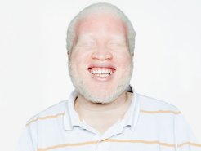
Albinism
Tyrosinase deficiency
Predisposed to skin cancer
Figure 3.7 Albinism

Slide 47

Vitiligo
Autoimmune antibodies against melanocytes
Loss of pigmentation
Predisposed to skin cancer
Figure 3.8 Vitiligo

Slide 48
Alkaptonuria (Ochronosis)
Homogentisic acid oxidase deficiency
Tyrosine builds up
Urine turns black when exposed to air

Slide 49
Maple Syrup Urine Disease
Involves branched chain amino acids
Defective renal transport of these amino acids
LEUCINE
ISOLEUCINE
VALINE

Slide 50
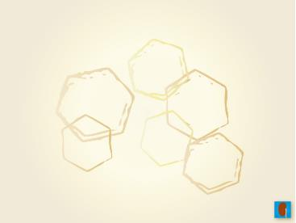
Cystinuria
Defective renal transport of amino acids
Hexagonal, envelope shaped, or coffin lid shaped crystals in the urine
CYSTIENE
ORNITHINE
LYSINE
ARGININE

Slide 51
THE END
TO BE CONTINUED…

